Slide 1

Please take notes

Slide 2
Announcements
To schedule an appointment, please do so through: https://professor-carol-weisse.youcanbook.me/
Weekly updates (includes job postings, clinical opportunities, educational opportunities)
Grand Rounds Ellis Hospital 8-9:00 am Fridays
Joan Nicole Prince Home Training June 18th & June 20th 10:00a-3:00pm. You must call (518-346-5471) or
e-mail Amanda Neveau volcoorjnp@gmail.com in advance of training.

Slide 3
Goals of Today’s Meeting
At the end of this meeting, you should be able…
To understand the steps involved in the application process including those required to have a committee letter submitted on your behalf
To distinguish between your responsibilities and what the Health Professions Office will do in support of your application
To obtain information from former applicants
KEEP IN MIND: neither Prof. Beaton, Prof. Weisse, nor Sabrina have been through the application process, so outside of the information we provide today, you will really need to read directions that come with each application very carefully.

Slide 4
Our Job vs. Your Job
  HEALTH PROFESSIONS OFFICE:
  Send committee packet (including individual letters) to all schools designated by you in your application.

Slide 5
Your Job
  Complete application carefully (we do not proof read)
  Request registrar(s) office send your official transcript to schools/application services (AMCAS, ACOMAS, AADSAS)
  Wait to see test scores (MCAT/DAT/OAT/PCAT etc..) before applying
  Maintain tracking system for managing primary and secondary applications, payments, application status
  Provide our office (health_pro@union.edu) with:
    Pdf of your final, submitted application
    Letter request form
    Update letter if reviewed prior to this year
    NOTE: please provide everything in one email

Slide 6

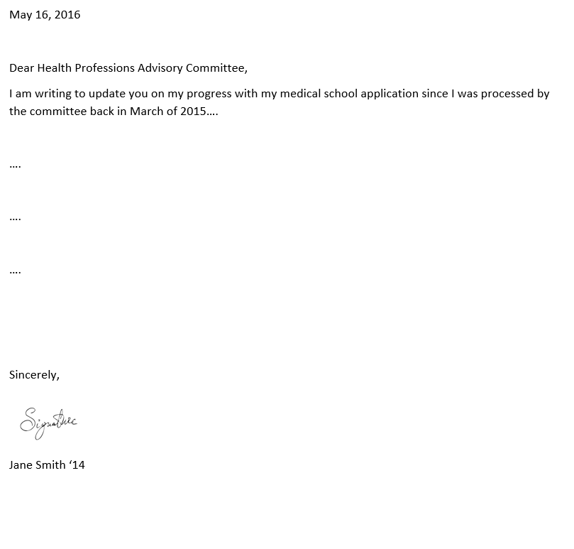
Update Letter Format
Formal
Typed
1 page limit
Dated
Addressed “Dear Health
Professions Advisory
Committee”
Signed
Send electronically as pdf to:
  Health_pro@union.edu
Note: your update letter will be sent directly to
schools along with committee letter

Slide 7
Timing matters!
20,000+ applicants (nearly half of the applicant pool) apply June/July
We will work on committee letters in the order with which we receive your completed applications (Sabrina is out for most of August)
Early is good - error free is better
You should complete secondary applications within 2 weeks of receiving access (everything for your submission should be completed over the summer)
Note: our timeline for submitting your letter is different than your timeline!

Slide 8
Most common reasons for delays:
Courses listed on application don’t match official transcript
Missing coursework/incomplete transcript
Transcript missing (from every school attended even if course transferred)
Unofficial transcript

Slide 9

Keep in mind when submitting application…
Turn off spam-or check spam folder regularly
Use professionally sounding e-mail
Check e-mail regularly

Slide 10
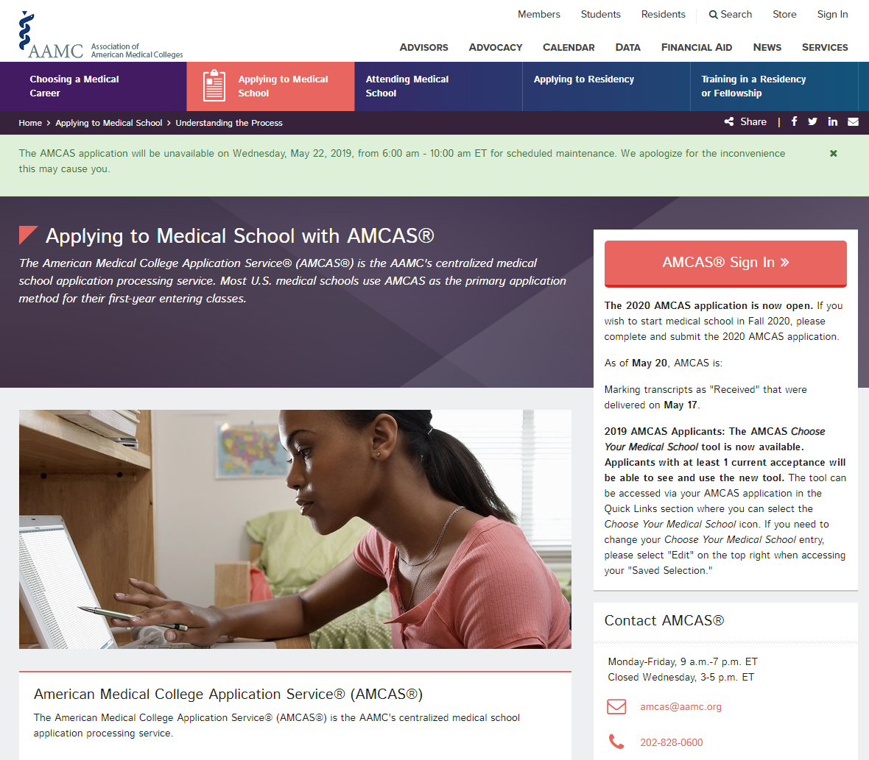

aamc.org/amcas

Slide 11


How does AMCAS work?
Application Submitted
Applicant completes & submits AMCAS application online
Application Processed
Applicant arranges for all required official transcripts to be sent to AMCAS
Application Delivered
AMCAS distributes verified application to designated med schools
AMCAS performs verification of coursework and calculates AMCAS GPAs
AMCAS delivers letters to designated med schools as they are received
Applicant pays submission fees (or uses valid Fee Assistance Program benefits)
aamc.org/advisors

Slide 12

AMCAS Verification Process
Transcripts
All required official transcripts are required before an application can join the verification queue
  AMCAS accepts PDF eTranscripts from approved senders
  Processing
  From date of “Ready to Review” application status, about 6 weeks
  Find processing updates on Twitter (@AMCASinfo) and on the AMCAS application sign in page
All Official Transcripts
Received
Application
Submitted
Verification Queue
Notes:
Applications are placed in the verification queue as soon as AMCAS receives your submitted electronic application and all of your required official transcripts. When requesting transcripts from your registrar(s), use the Official Transcript Request form that is generated from within the AMCAS application. The form helps AMCAS match transcripts accurately. AMCAS does accept electronic PDF eTranscripts from approved senders, however, most schools that have the ability to send eTranscripts are not yet AMCAS-approved senders. (Talk with the registrar at your institution before recommending this option to your students.)
The verification process takes about 6 weeks from the time an application reaches the status of “Ready to Review”. In order to ensure this process goes as smoothly as possible, check the AMCAS Instruction Manual and watch the video tutorials to ensure that all coursework—particularly AP credit and study abroad coursework—is entered accurately before submitting your application. In order to verify an application, AMCAS does a line-by-line comparison of all of the coursework you entered into your application to what is on your official transcripts. They will also calculate your AMCAS GPAs which are normalized GPAs which allow medical school admissions officers to compare students’ GPAs from different schools and programs.
AMCAS posts processing updates on the application sign in page almost every morning. They also provide processing updates on Twitter so you can gauge where you are in the verification queue. Follow @AMCASinfo or visit the AMCAS Twitter page for regular updates on processing.

Slide 13
The AMCAS Application
Identifying Information
Schools Attended
Biographic Information
Course Work
Work/Activities
Letters of Evaluation
Medical Schools
Essay(s)
Standardized Tests

Slide 14
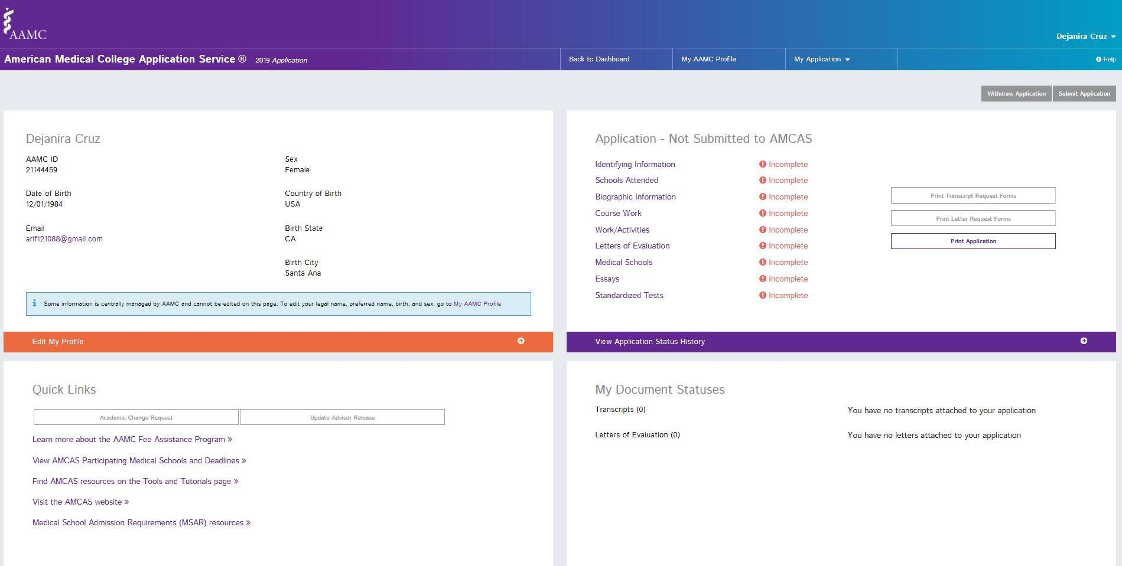
AMCAS Main Menu
Notes:
Once you log into the AMCAS application, you will see this Main Menu. You can access the application sections from the top horizontal bar or as they are listed in the center. You can only access certain sections once you have completed others, for example. You cannot complete the Course Work section until you have listed your schools in the Schools Attended section.
Check the status of your application, letters of evaluation, and transcripts received on the left hand side of the application by clicking the “Details” link. Print the Letter Request form and Transcript Request Forms from this screen.

Slide 15
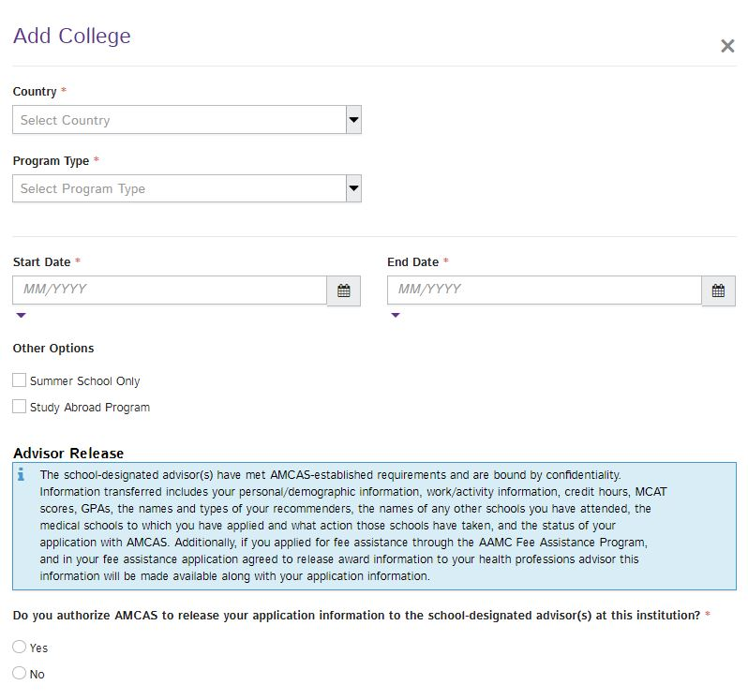
2. Schools Attended
Please check yes
Notes:
Enter high school and any post-secondary institution(s) that you have attended into this section even if no credits were earned.

Slide 16
Institutional Action
"Were you ever the recipient of any institutional action by any college or medical school for unacceptable academic performance or conduct violation even though such action may not have interrupted your enrollment or required you to withdraw?”
“You must answer ‘Yes’ even if the action does not appear on or has been deleted from your official transcripts due to institutional policy or personal petition.”

Slide 17

Institutional Action
Any and all points ever received must be reported (not limited to those currently on file in the Dean of Students office)
Any honor code violations
Any conduct issues
If you have an institutional action AFTER submitting your AMCAS, it must be reported to AMCAS within 10 days.

Slide 18

Document carefully
Doctors need to be careful, accurate, and clear when documenting their work

Slide 19
The Essay: Consider writing this first (before experiences)
A narrative that conveys:
1. Why applicants are motivated
2. Why applicants are prepared to pursue medical training for this career.
3. What applicants hope to contribute to future patients, their colleagues, and their community.
It should contain specific experiences and details and convey these through brief stories (show, don’t tell)
Not a place to reveal your deepest, most personal thoughts or opinions about the field of medicine
Consider completing this self-assessment first: Anatomy of an Applicant Tool
Do your experiences “knit” into a theme? Has your journey included any special hurdles? Are there aspects of your transcript that warrant explanation? (ie leave of absence, withdrawal due to NHS etc..)

Slide 20
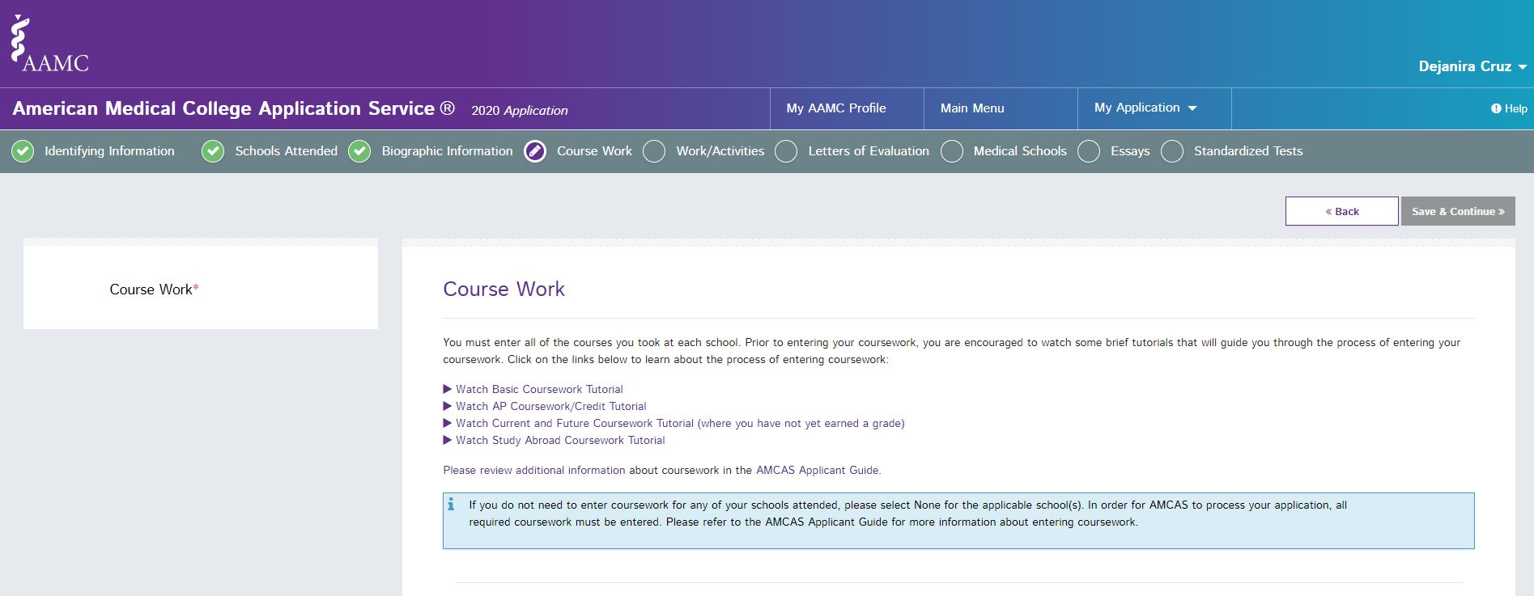
4. Course Work
Notes:
The fourth section of the application is Course Work. This is typically the section that takes the most time to complete. You will see that the schools you entered in section two are shown here in the schools attended box, and you will enter information about all of the courses you took at this school.
There are links in this section to video tutorials that demonstrate how to enter some of the different types of coursework you might have such as study abroad coursework or AP credits.

Slide 21
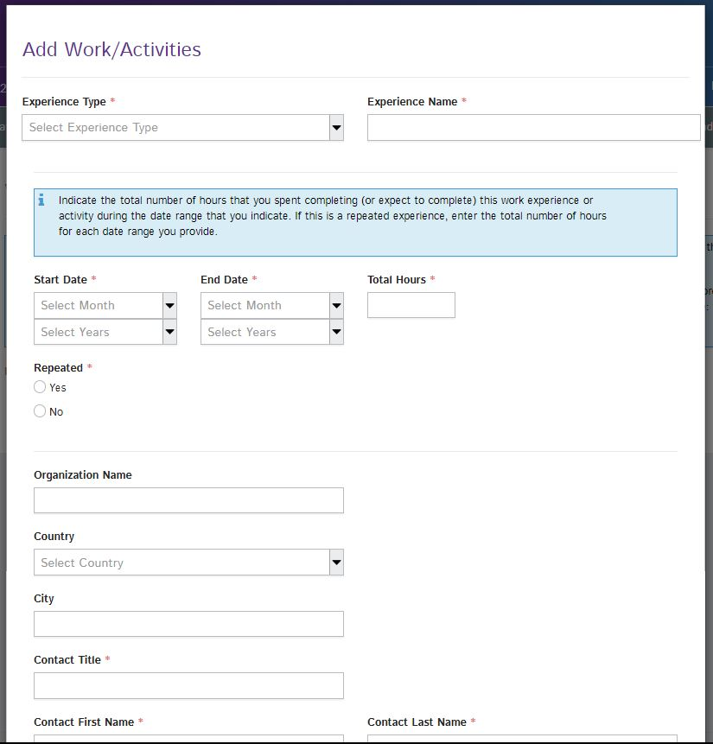
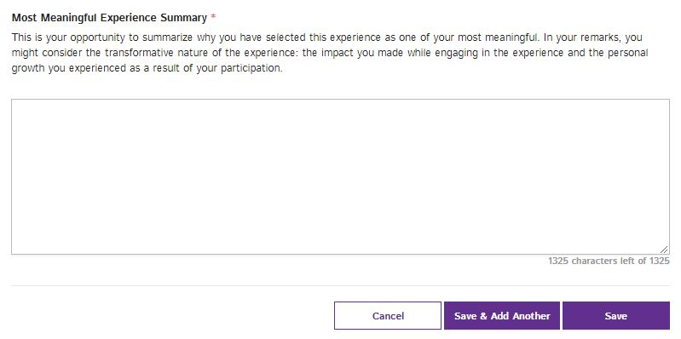
5. Work/Activities
Maximum of 15 entries
  Applicants can enter 3 additional date ranges for repeated activities
Maximum of 3 “Most Meaningful”
Notes:
Section 5, “Work and Activities”, is where you have an opportunity to share with medical schools all of your work experiences and activities. You may add up to 15 entries in this section; for most activities, you are required to list a contact person and either an email or phone number, so that medical schools may verify this information if they so choose. You may select up to 3 experiences as the “Most Meaningful” where you will be provided with an additional prompt and asked to reflect on the experience a bit more.
You can include repeated experiences so instead of entering a summer job three times, you would enter it once and indicate repeated date ranges for those periods during which you held this position. You can enter up to four separate date ranges for a single experience, and you can also enter future dates up to the start of your potential matriculation year (so for the 2016 cycle, this would be August 2016).

Slide 22
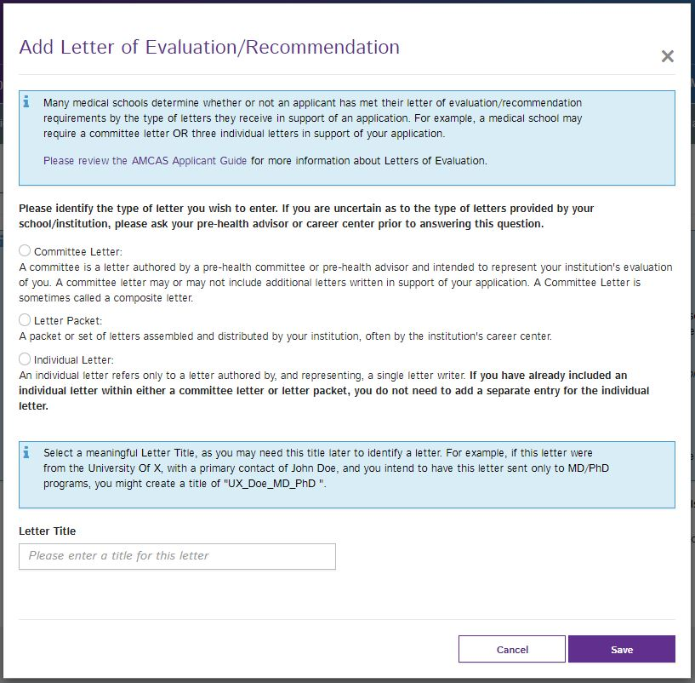
6. Letters of Evaluation
Applicants can submit their application before AMCAS receives their letters.
Notes:
The sixth section of the application for you to enter contact information about who will be submitting Letters of Evaluation on your behalf. You will indicate which type of letter will be sent for each letter entry—a committee letter, a letter packet, or an individual letter. Up to 10 letter entries may be added to the application, but that does not mean that medical schools wish to receive 10 letters per applicant. AMCAS allows this many entries to permit you to target specific letters to certain schools if you want to. Most applicants have 2 or 3 letters. Letter packets cannot be broken up once they are received by AMCAS.
If you are working with a pre health advisor or a career center to send your letters to AMCAS, you may want to check with them for specific instructions about filling out this section. You are required to provide contact information for your letter authors. This information will be used to generate the letter request form that you will give to your letter writers. This form is important as it contains your AAMC ID number and the letter ID number for this specific letter which will help AMCAS match it to your application.
Remember, you can submit your application before AMCAS gets your letters since they are not required to verify your application.

Slide 23
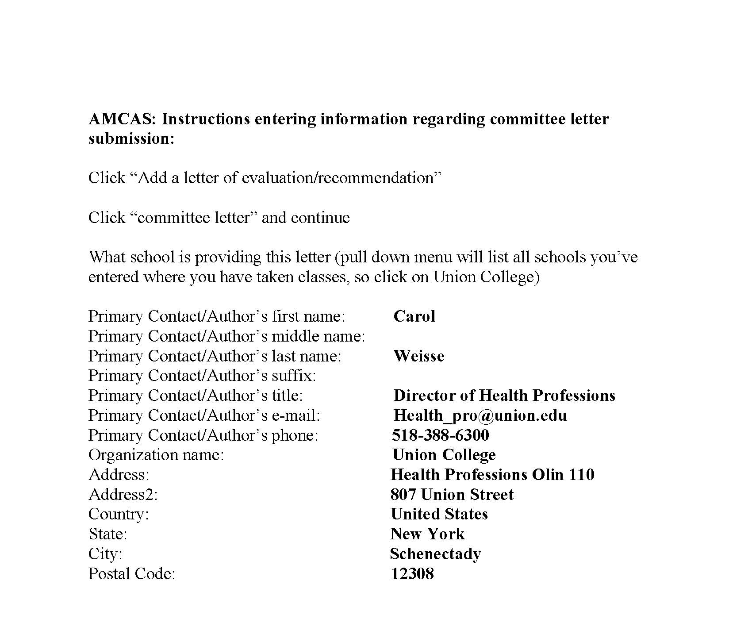

Slide 24
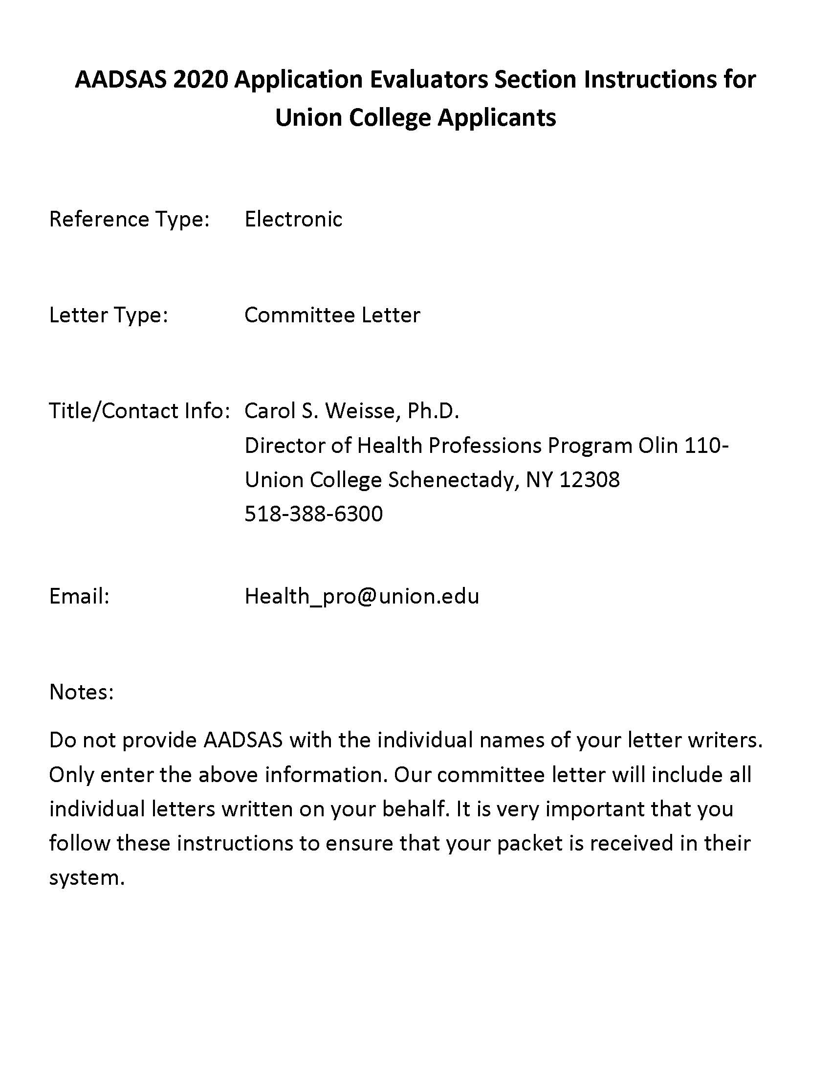

AADSAS Letter request instructions
NOTE: e-mail address is not my direct e-mail

Slide 25
M.D. AND D.O. USE SEPARATE APPLICATION SERVICES
How to Request Letters of Recommendation through AACOMAS Application System.

Slide 26
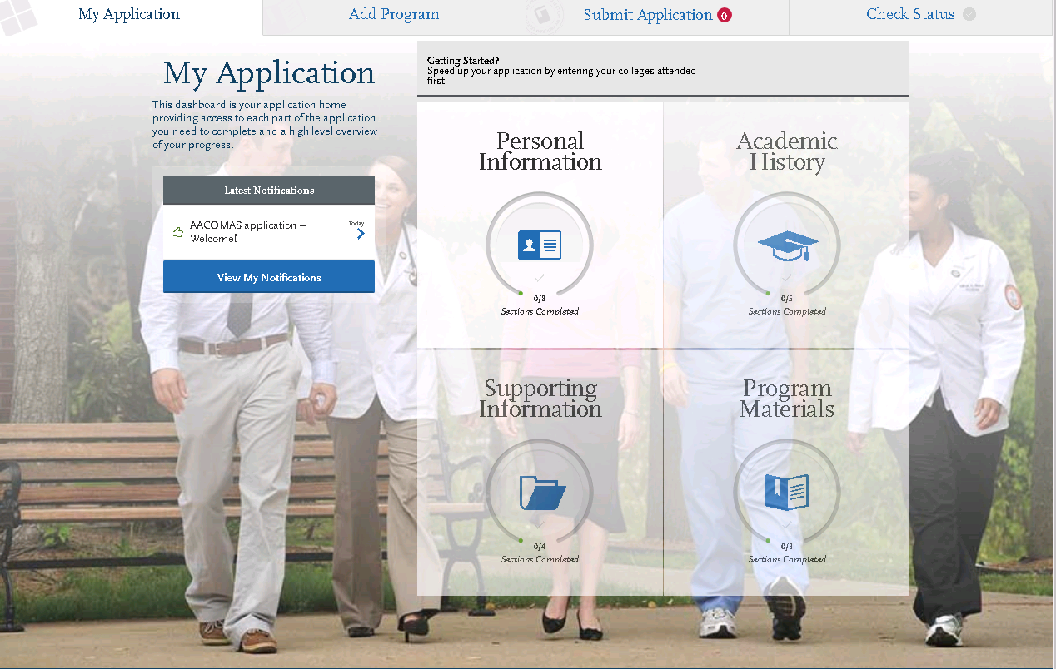

Steps for requesting our committee letter through AACOMAS
On the home screen of your AACOMAS application, select Supporting Information

Slide 27
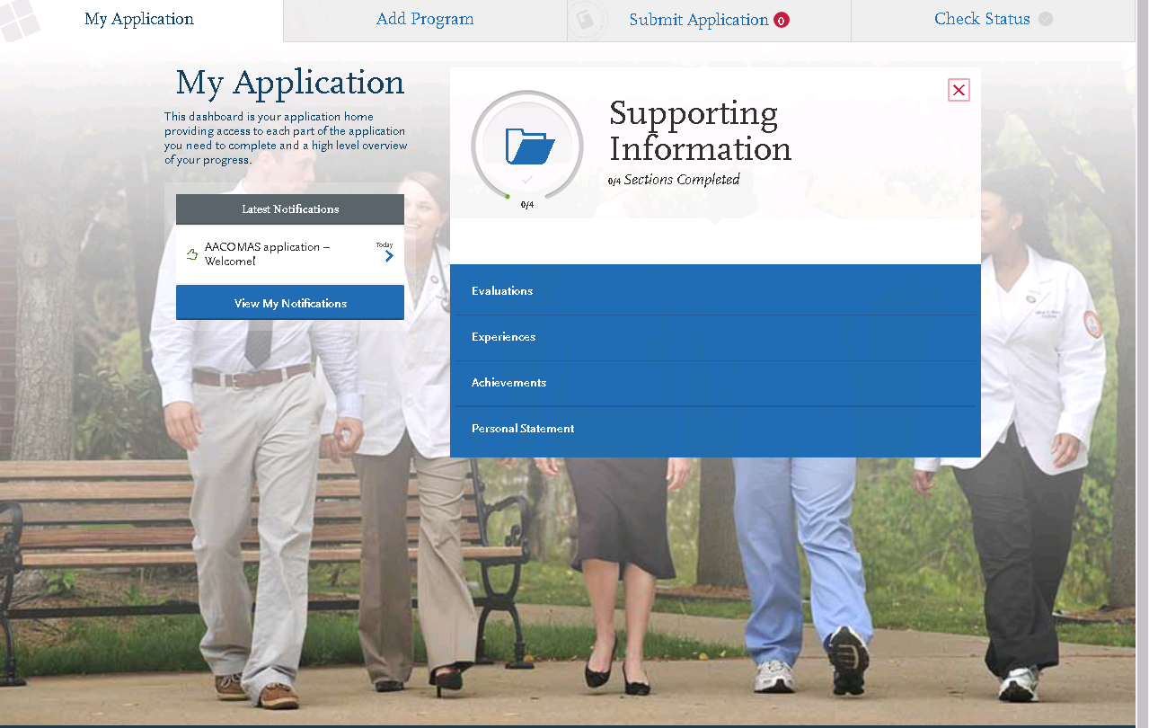

From the home screen “My Application” you will select the box labeled, “Supporting Information”, then select “Evaluations”
Select: Evaluations

Slide 28
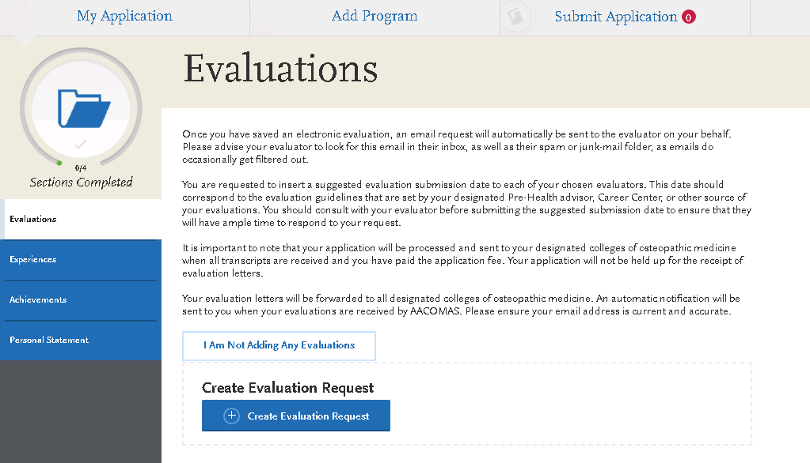

Select “Create Evaluation Request”
You will select Create Evaluation Request

Slide 29
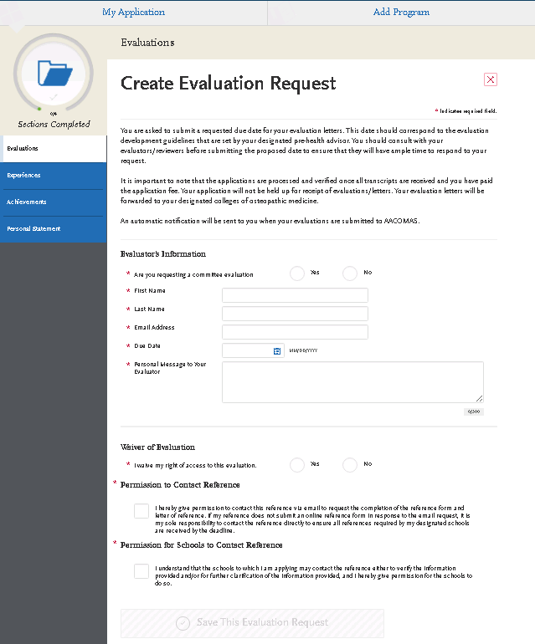

Complete the following steps to have your committee letter sent to AACOMAS through the Health Professions Office.
Evaluator’s Information
Select “Yes” you are requesting a committee evaluation.
First Name- Carol
Last Name – Weisse
Email address- health_pro@union.edu
Due Date- 08/31/2019
Personal Message/Notes:
“Please submit the Committee Letter written on my behalf.”
Waiver of Evaluation
Select the answer that matches your Waiver Form on file with Health Professions Office.
Check both boxes.
Click the Blue “Save This Evaluation Request” box.

Slide 30
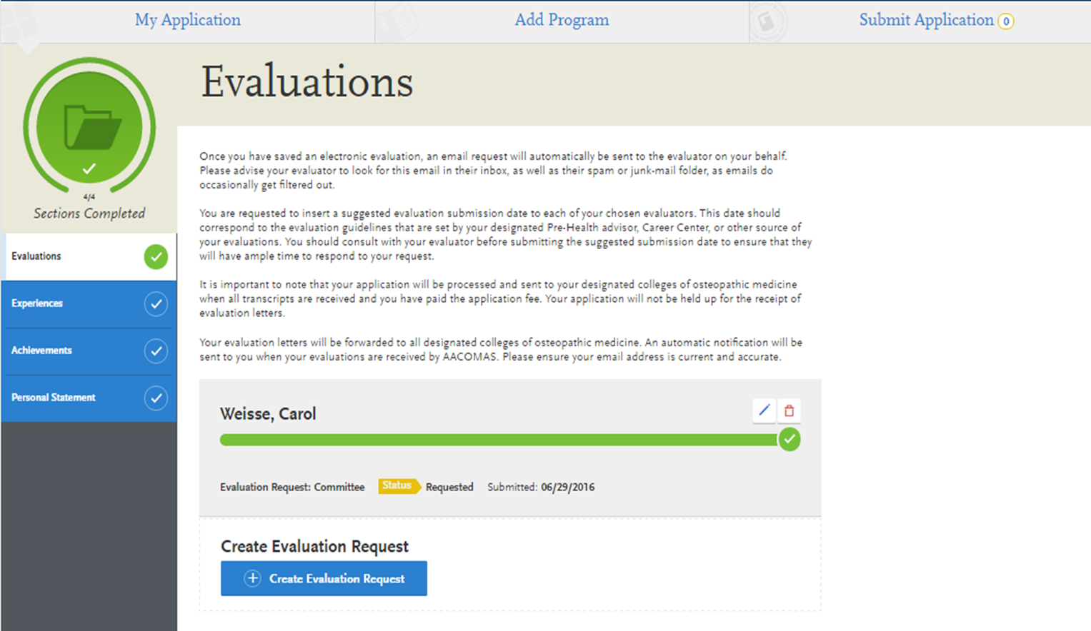

Slide 31

Committee letter includes all reference letters
You do not need to request any individual letters

Slide 32
Application Tips
  Before submitting your application, print it out and review it very carefully for missing courses or grades as well as for typos and errors.
  Monitor the status of transcripts & remember that transcripts must be official
  Look for emails from AMCAS@aamc.org regarding problems or delays
  Review verified coursework immediately after AMCAS processing is complete

Slide 33




AMCAS Tools
AMCAS Applicant Guide
Application and Acceptance Protocols
Video Tutorials
  youtube.com/AMCASinfo
Twitter
  @AMCASinfo
aamc.org/amcas
Please do not e-mail Sabrina with questions on how to answer questions on an application.
Notes:
For tools to help you through the application process, visit www.aamc.org/amcas for resources about the entire application journey and the actual AMCAS application. Look through the Quick Start Guide, the AMCAS Instruction Manual, or watch video tutorials by going to the AMCAS resources section of the website, so you will be prepared and informed when the application opens in May. We will have the 2016 AMCAS application resources available on April 1.
Again, for processing updates and other AMCAS-specific information, follow us on Twitter @AMCASinfo and watch our video tutorials on YouTube.

Slide 34
Timeline
June - submit application once spring term grades are received; provide our office with copy of application
July/August - complete secondary applications
September - monitor application status at schools on-line
Oct-January (or later) - interviews/notifications-acceptances, rejections, waitlists
May - update our office/reapplication necessary? (note: most waitlist movement occurs during this month)

Slide 35

If you are not applying this cycle:
Contact our office in January the year before you hope to begin school.
Provide us with a 1-page formal update letter when you are ready to apply.

Slide 36
Please Ask Any Questions Now

